Slide 1
Lecture 1

Slide 2
Introduction
A pointer is derived data type
It contains the memory addresses as their values
It can be used to access and manipulate data stored in the memory

Slide 3
Advantages of Pointer
Pointers can be used to return multiple values from a function via function arguments
    void calculate(int a, int b, int *sum, int *diff) {
    *sum = a + b;
    *diff = a - b;
    }

Slide 4
Continue…
Passing a functions as arguments to other functions.
      void add(int a, int b) {
      printf("Sum = %d\n", a + b);
      }
      void operate(void (*func)(int, int)) {
      func(10, 20); // calling passed function
      }
      int main() {
      operate(add);
      return 0;
      }

Slide 5
Continue…
The use of pointer arrays to character string results in saving of data storage space in memory.
    char country[3][20] = {"India", "USA", "Japan"};
    By using pointer
    char *country[3] = {"India", "USA", "Japan"};
Pointers allow for dynamic memory management.
    int *p;
    p = (int *)malloc(5 * sizeof(int));

Slide 6
Continue…
Pointers provide an efficient tool for manipulating dynamic data structures such as structures, linked lists, queues, stacks and trees.

Slide 7
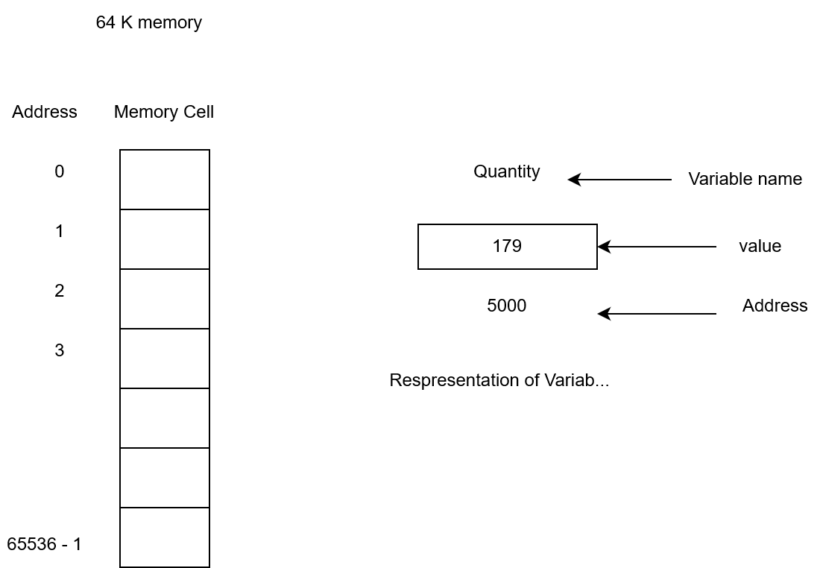
Memory Organisation

Slide 8
Note
Memory addresses are simply numbers; they can be assigned to a variable. That can be stored in memory, like other variables.
Variables that hold memory addresses are called pointer variables.
Therefore, a pointer variable is a variable that contains an address, which is the location of another variable in memory.

Slide 9
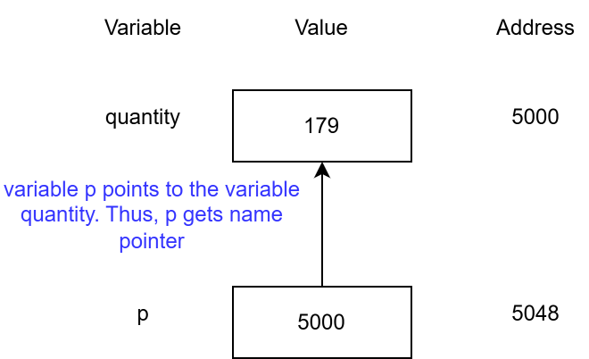
Pointer variable

